Slide 1


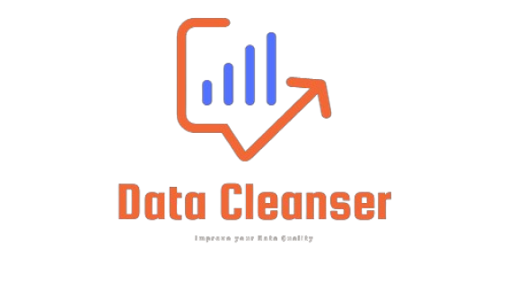
Design and Implementation of Data Cleansing System
Notes:
name of project alone in a page

Slide 2
Data cleanser
Clean Up Your Data Now!
With Data Cleanser
Founders:
Improve Your Data Quality
Mohammed Ahmed Rashad
Abdelrahman Ghoniem
Mohamed Adly
Mohammed Abd El Motaleb
Toka Saied
Eyad Ahmed Ali Emam
Mohammed Osama
Mohammed Abdelkarim
Contact: data-cleanser@company.com

Slide 3


Supervised By:
Dr. Assem ElAshaar
Dr Omar Khalid

Slide 4



Data Cleaning
Presentation
Spring 2024
By
1-Mohamed Ahmed Rashad
2-Mohamed Osama Abdelghany Abdallah
3-Mohamed Adly
4-Eyad Ahmed Ali Emam
5-Toka Saied Youssef
6-Mohammed Abdelkarim Mohammed
7-Mohammed Abd El Motaleb
8- Abdelrahman ghoniem ghoniem

Slide 5
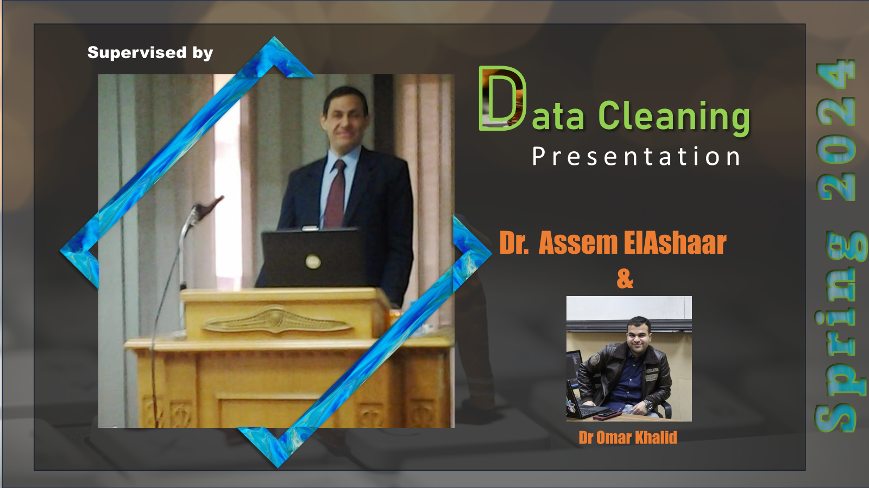
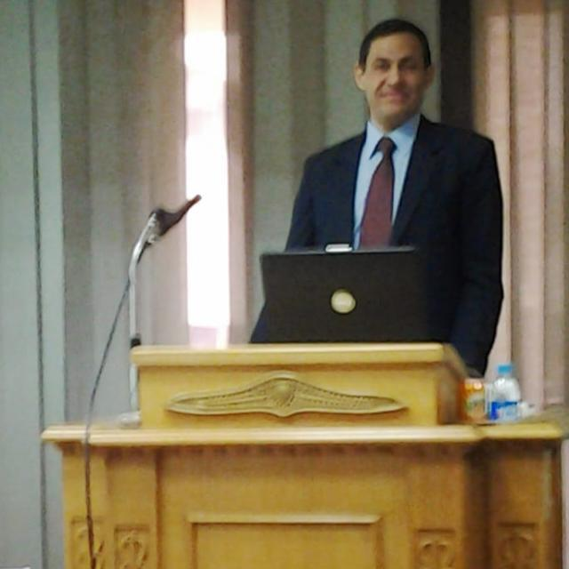
Supervised By
Dr. Assem ElAshaar
Dr Omar Khalid

Slide 6
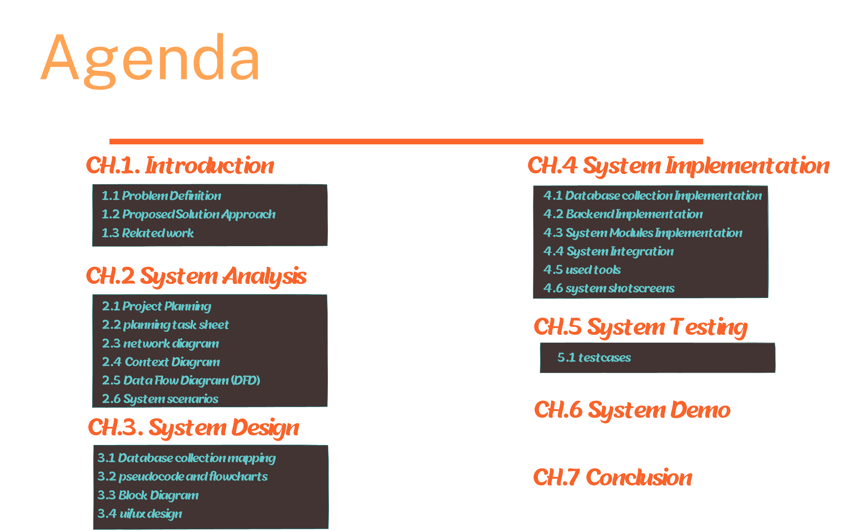

Slide 7

Ch.1
Introduction

Slide 8
Introduction
"In the era of big data and advanced analytics, data quality plays a critical role in making informed decisions and achieving sustainable success. However, many organizations face significant challenges due to dirty and inaccurate data, leading to poor decisions, wasted resources, and even legal issues "

Slide 9
Introduction
"A Data Cleansing Project is a crucial step in any effective data management strategy, as it helps improve data quality and enhances organizational confidence in the information they rely on. By employing advanced techniques and tools, errors can be identified and corrected, redundant or duplicate data can be removed, and various data formats can be standardized."

Slide 10

Introduction
However, some of the common features of data include:
cleansing systems
Data identification
Data correction
Data validation
Data reporting
Data Exporting

Slide 11
Improved Decision-making
Clean Data Leads To Better Insights And More Informed Decisions.
Reduced Costs
By Eliminating Errors, You Can Save Money On Wasted Resources And Fraud Prevention.
Increased Efficiency
Clean Data Can Help You To Automate Tasks And Improve Your Overall Efficiency.
Enhanced Customer Satisfaction
Clean Data Can Lead To A Better Customer Experience.
Introduction

Slide 12

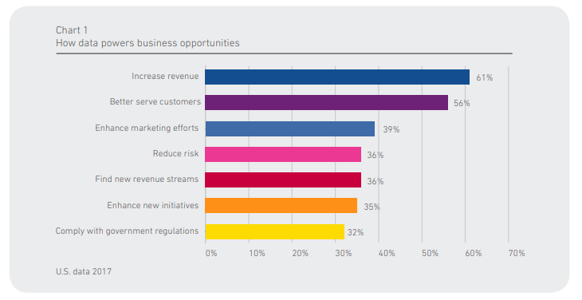
Data Powers
Reference
Click Here

Slide 13
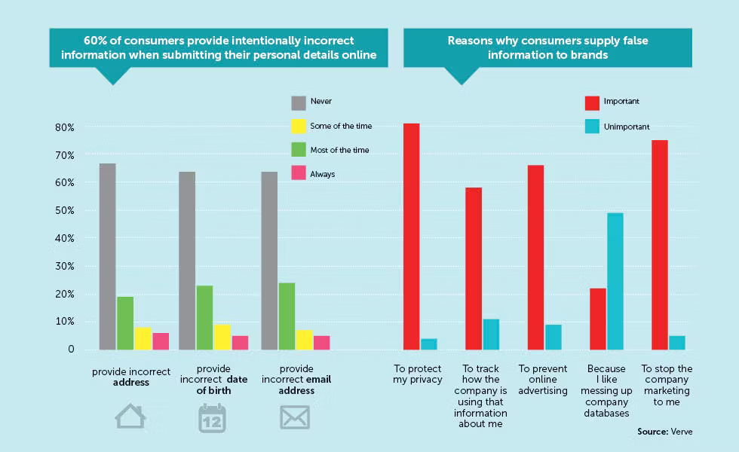
Introduction
Reference
Click Here

Slide 14








M.Rashad
M. Osama
M. Adly
Eyad Emam
Team member
Toka saeid
M. Alammar
M. Abdulmutallab
A.Ghoniem

Slide 15
Main Tasks
M.Rashad
M. Osama
M. Adly
Eyad Emam
planning
Design
Presentation
Back-end
Integration
Survey
Analysis
front-end
Documentation
Survey
Design
Back-end
analysis
Presentation
documentation
Researches
Design
Front-end
Integration
analysis
Planning
Survey
documentation
Survey
analysis
Design
front-end
Documentation
Presentation

Slide 16
Main Tasks
Toka saeid
M. Alammar
M. Abdulmutallab
A.Ghoniem
Problem definition
Survey
front-end
Design
analysis
Integration
Documentation
Problem definition
Design
analysis
Survey
front-end
Documentation
Planning
Researches
Design
back-end
Survey
Documentation
analysis
Problem definition
Planning
documentation
Survey
analysis
Design
back-end
presentation

Slide 17
1.1 Problem definition
Given that
Current data is plagued by inconsistencies, inaccuracies, and duplicates. This leads to unreliable analysis, poor decision-making, and inefficient operations.
Such that
Data-driven decisions are based on reliable and accurate information.
Analysis becomes more efficient and insightful due to cleaner data.
Operational costs are reduced by eliminating errors and redundancies
It is required to have a system to
Data analysis: Identify inconsistencies, inaccuracies, and duplicates.
Correction: Achieve high accuracy in fixing errors automatically.
User-friendliness: Monitor, manage, and generate reports with ease.

Slide 18
1.2 Proposed Solution Approach:
1-our system removes duplicates from any dataset or database
2-our system handles missing values in any dataset or database
1-remove duplicates
5-generate reports
DC
2-handle missing values
3-our system handles most of invalid formats in any dataset or database
4-our system removes outliers from any dataset or database and generates required diagrams like line chart,histogram,etc…
5-our system generates reports to track changes that happen before and after processing
4-remove outliers
3-handle invalid formats

Slide 19



1.3 Related work
# | Name | Link | Advantages | Disadvantages
1 | Winpure | https://winpure.com/ | Industry-leading Data Matching Tool, quick, intelligent and easy-to-use | Complexity: Some users have found the software to be complex, requiring training to fully utilize all its features. Exporting Results: Exporting the results of matching can be cumbersome and not user-friendly.
2 | Open refine | https://openrefine.org/ | It has an easy to use interface OpenRefine supports a wide variety of data | Some users complain that the user interface looks a bit dated
3 | KnowledgeNet | https://kn-it.com/ | Connected view of relationships beyond 1st & 2nd degree connections. ease of use and the insights that KN gives on people | Not having a tool prior to KnowledgeNet and not fully leveraging the power of the tool on clients

Slide 20


1.3 Related work
# | Name | Link | Advantages | Disadvantages
4 | Demand tools | https://www.validity.com/demandtools/ | Straightforward UI that does what it needs to do. Makes after-the-fact de-duplication a breeze. Easy mass updates to data sets - making cleaning data a breeze. | UI is outdated and could use a bit of a facelift. Some competitors in this space are more all-in-one tools where DemandTools. Lack of automation for regular data cleansing - everything we use DemandTools for is manual.
5 | Sage master | https://openrefine.org/ | Streamlined Financial Management Enhanced accuracy Time and cost savings Scalability Reporting and analytics | Initial setup complexity High Learning curve Cost of ownership Limited mobility Compatibility issues

Slide 21
Detailed Task Assignment
detailed xlsx file

Slide 22

Ch.2
system analysis

Slide 23
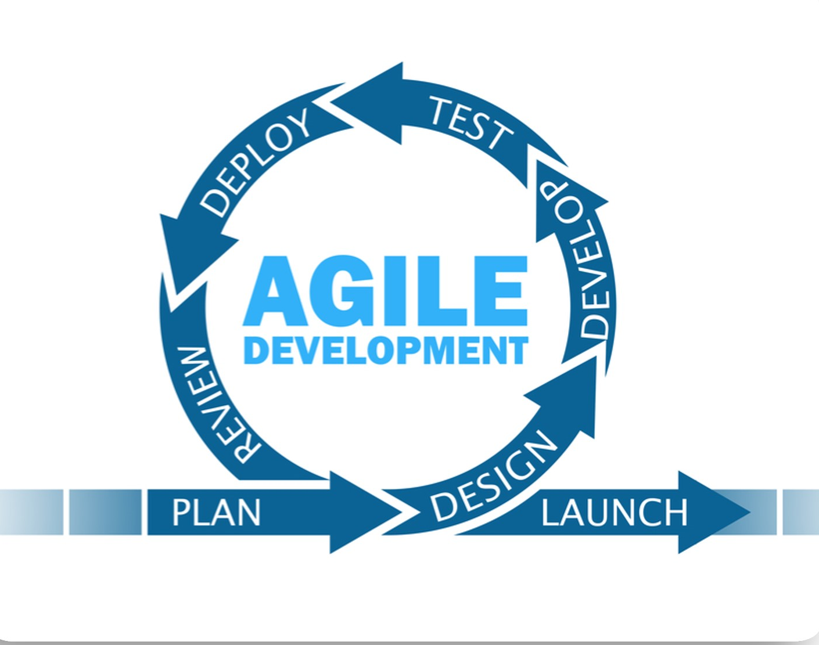
2.1 Project Planning
We are an agile self developing team as chose agile methodology as it's in our think the best way to keep up the teamwork spirit and stay focused through the process in presenting deliverable items at the end of each sprint

Slide 24
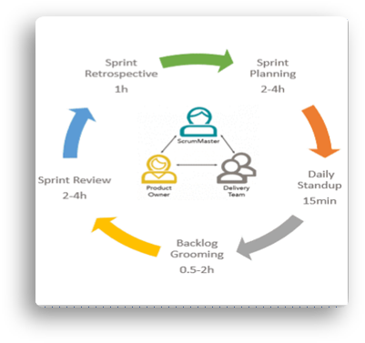
2.1.2 AGILE FRAMEWORK SELECTION:
We chose to work with a scrumban framework that depended on many thing we did in the last sprint like
1- Sprint planning
2- Daily start-up meetings
3- Backlog Grooming
4- Sprint review
5- Sprint retrospectives

Slide 25
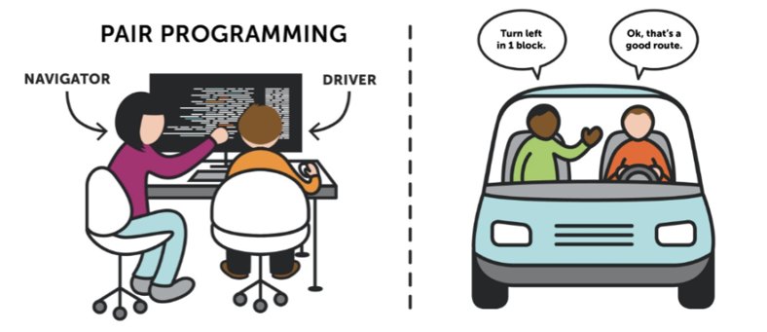
2.1.4 WORKFLOW:
We chose to work with pair programming technique where a task can never be hold by only one member
-pair programming is an integrated practice From xp(extreme programming ) framework
-this can help the team to improve their teamwork skills and team management skills

Slide 26
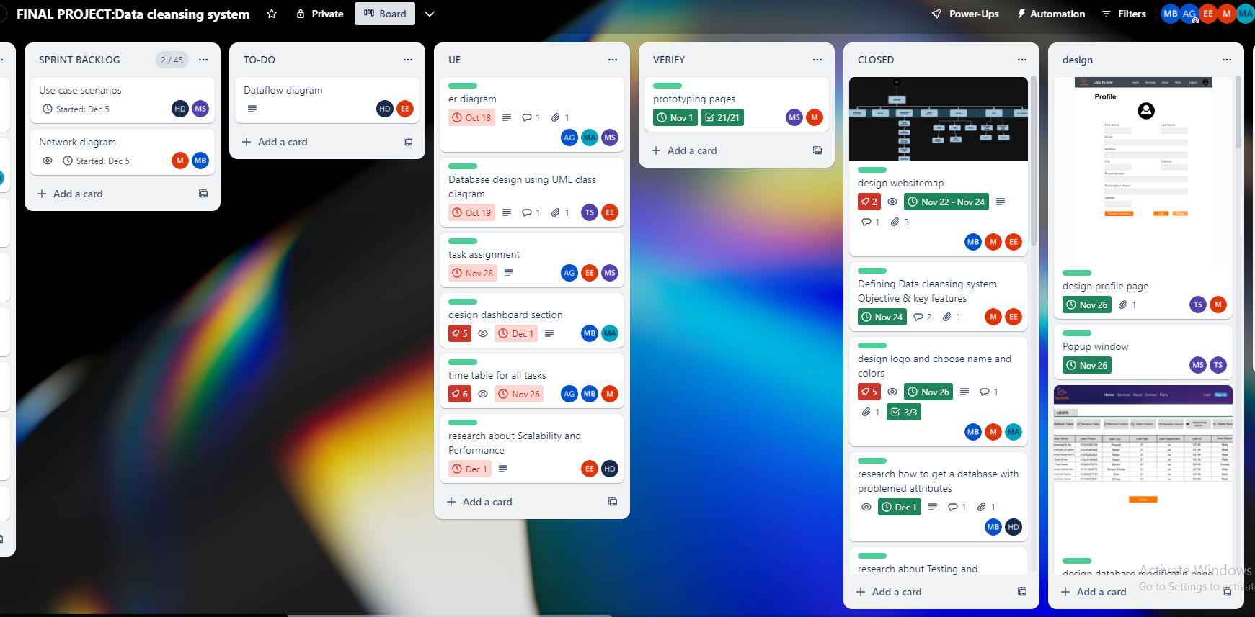
2.1.3 BOARD MANAGEMENT
﻿https://trello.com/b/5xonGb74/final-projectdata-cleansing-system﻿

Slide 27
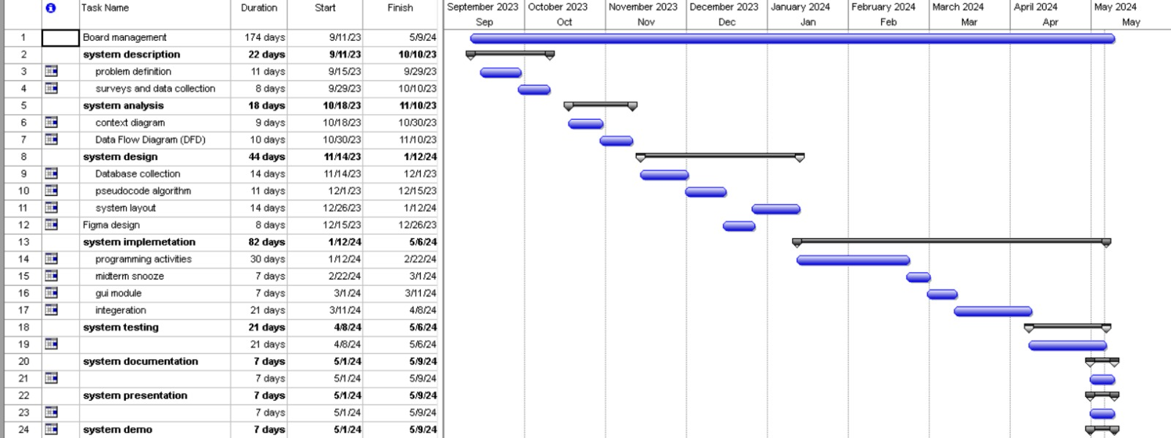
2.2 planning Task sheet (work breakdown)& Gantt chart

Slide 28
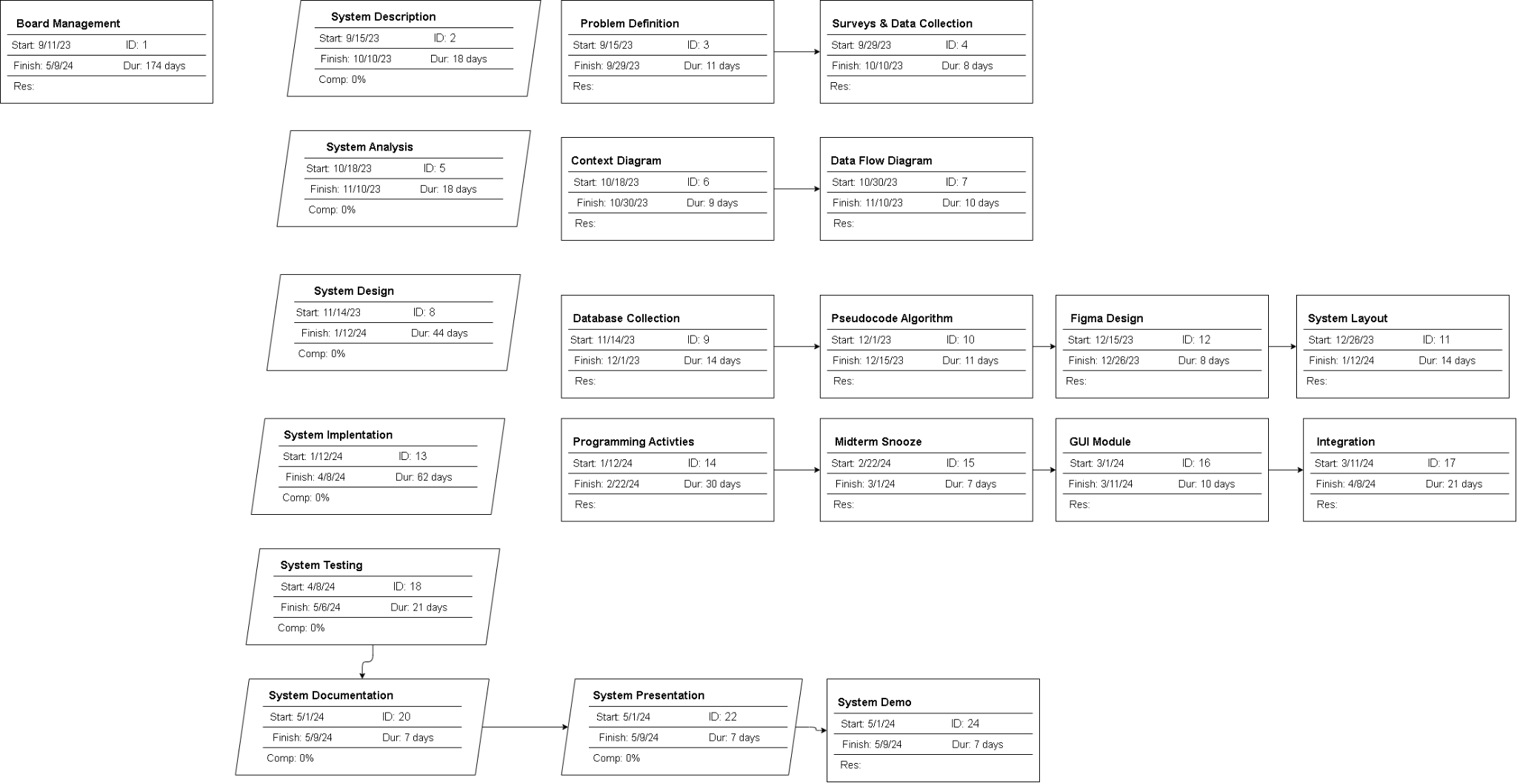
2.3 Network Diagram

Slide 29
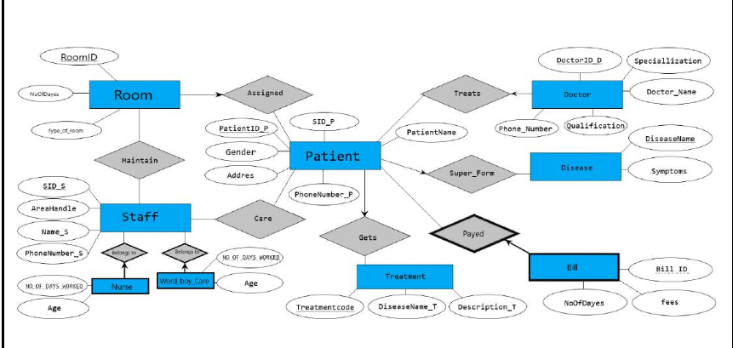
Planning Task sheet (work breakdown)& Gantt chart

Slide 30
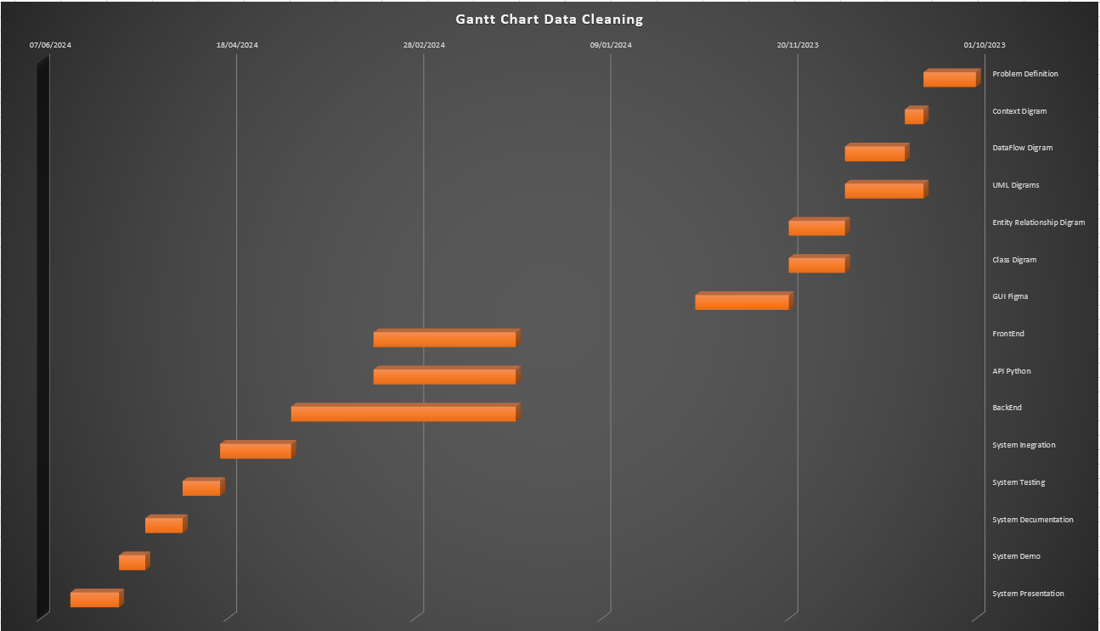
planning Task sheet (work breakdown)& gantt chart

Slide 31
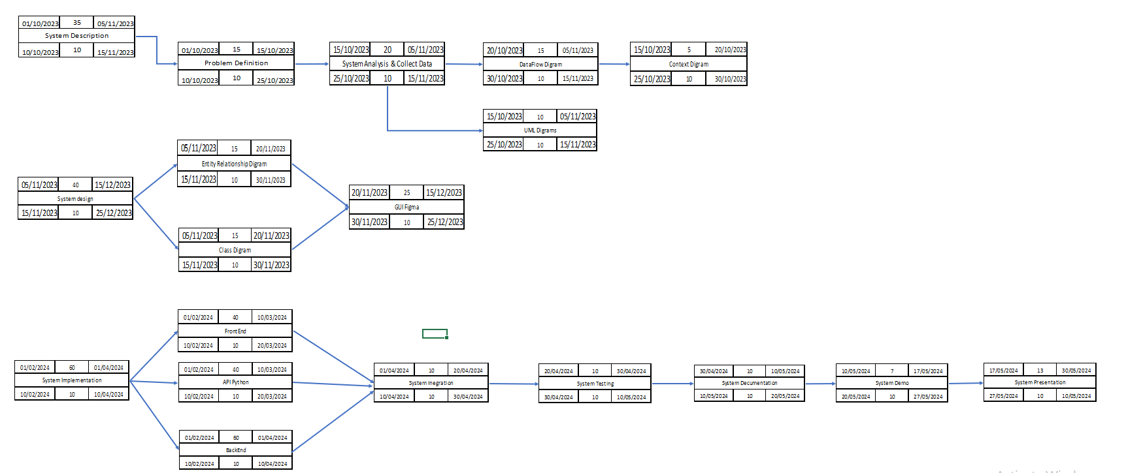
Network Diagram

Slide 32
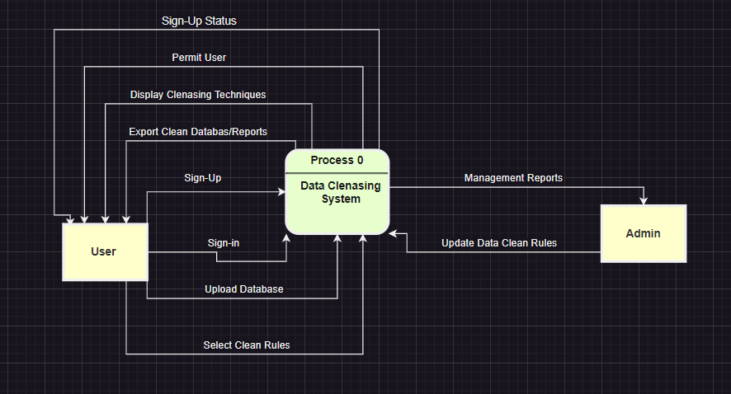
2.4 Context diagram

Slide 33
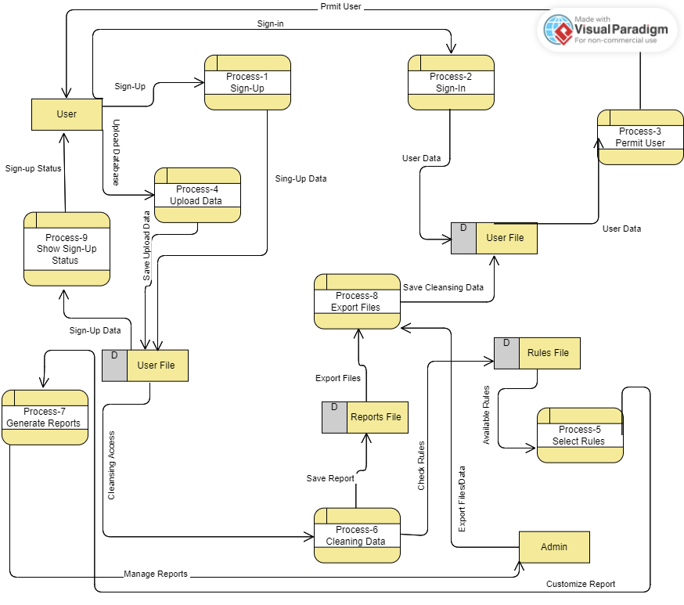
2.5 DFD diagram

Slide 34
DFD Level (0) Process
1.0: Sign-Up
The user initiates the sign-up process by providing their user data.
2.0: Sign-In
The user signs in to the system using their credentials.
3.0: Permit User
The admin permits the user to access the system.
4.0: Upload Data
The user uploads their data to the system.
5.0: Select Rules -> The user selects the rules for data cleansing.
6.0: Cleaning Data -> The system cleanses the uploaded data based on the selected rules.
7.0: Generate Reports -> The system generates reports based on the cleansed data.
8.0: Export Files -> The user exports the generated reports in a file format.
9.0: Show Sign-Up Status -> The system displays the sign-up status to the user.

Slide 35
DFD Level (0) Data stores
context diagram entites
1. User File
2. Rules File
3. Reports File
1. User File
2.Admin
DFD Level (0) Data Entities
1. User
2. Admin

Slide 36
2.6 User & system scenarios:-
We thought of 30 system scenarios that we can implement in our system
1- User Login: User, a Data Analyst, starts his day by accessing the data cleansing system. he navigates to the login page and enters his username and password.
2- Dashboard Overview : Once logged in, User is presented with a dashboard displaying recent activities, status of ongoing data cleansing processes, and notifications.
3- Upload Raw Data : User initiates a new data cleansing task by selecting the "Upload Data" option. he uploads raw data files from his local machine, including CSV and Excel files.
4- Select Cleansing Techniqes: User reviews the uploaded data and selects specific cleansing rules based on the data quality requirements. She chooses rules for handling missing values, removing duplicates, and standardizing formats.
5- Initiate Cleansing Process : With the selected rules in place, User initiates the data cleansing process. The system begins processing the data according to the defined rules.

Slide 37
2.6 User & system scenarios:-
6- Validation and Sanitization : The system validates and sanitizes the data, identifying and removing any anomalies, errors, or potential threats. It logs the cleansing activities for auditing purposes.
7- Data Review : Once the cleansing process is complete, User reviews the cleansed data using interactive visualization tools and data preview features provided by the system.
8- Approval of Cleansed Data : Satisfied with the quality of the cleansed data, User approves it for further use. he acknowledges the system-generated summary of changes made during the cleansing process.
9- Export Cleansed Data : User exports the cleansed data in CSV format to share with other team members for analysis. The system generates a download link, and User saves the file to his local machine.
10- Generate Data Cleansing Report : Before logging out, User generates a comprehensive report summarizing the data cleansing activities, including the number of records processed, errors identified, and the effectiveness of applied rules.
11- Logout : User logs out of the data cleansing system, ensuring the termination of hissession to maintain security.

Slide 38
2.6 User & system scenarios:-
12-Missing Values Detection: The system identifies columns with missing values and provides options for handling them, such as imputation or removal.
13-Imputation Strategy Selection: User selects the imputation strategy for handling missing values, opting for mean imputation for numerical columns and mode imputation for categorical columns.
14-Invalid Format Detection: The system detects columns with invalid formats, such as dates or phone numbers, and suggests standardization methods.
15-Standardization Method Selection: User chooses to standardize date formats to YYYY-MM-DD and phone numbers to a specific pattern.
16-Duplicate Records Identification: The system identifies duplicate records based on specified criteria, such as unique identifiers or combinations of attributes.
17-Duplicate Removal Strategy Selection: User selects a strategy for removing duplicate records, opting for keeping the first occurrence and discarding subsequent duplicates.

Slide 39
2.6 User & system scenarios:-
18-Outlier Detection: The system detects outliers in numerical columns using statistical methods like Z-score or IQR.
19-Outlier Removal Strategy Selection: User selects a strategy for handling outliers, choosing to remove them based on a predefined threshold.
20-Progress Monitoring: User monitors the progress of the cleansing process through the dashboard, observing the completion status and any encountered errors.
21-Error Handling: If errors occur during cleansing, User receives notifications and accesses detailed error logs to troubleshoot and resolve issues.
22-Data Quality Assessment: After cleansing, User assesses the data quality metrics provided by the system, including completeness, accuracy, and consistency.
23-Preview Cleansed Data: User previews the cleansed SQL data to ensure it meets the desired quality standards before proceeding.

Slide 40
2.6 User & system scenarios:-
24- User Access Management: User manages user access to the cleansing system, granting permissions based on roles and responsibilities.
25- Audit Trail Review: User reviews the audit trail of cleansing activities to track changes made to the data and maintain data governance compliance.
26- Documentation Generation: User generates documentation summarizing the cleansing process, techniques applied, and results achieved for record-keeping and compliance purposes.
27- Performance Optimization: User optimizes the cleansing process by fine-tuning parameters, such as batch size or parallel processing, to enhance efficiency and reduce processing time.
28 - Feedback Submission: User provides feedback on the cleansing system's performance and suggests improvements for future enhancements.
29 - Training and Support: User accesses training materials and support resources provided by the system vendor to enhance his skills and troubleshoot issues effectively.
30- System Updates: User receives notifications about system updates and new features, ensuring he stays informed about the latest improvements and enhancements.

Slide 41
Ch.3
system design

Slide 42
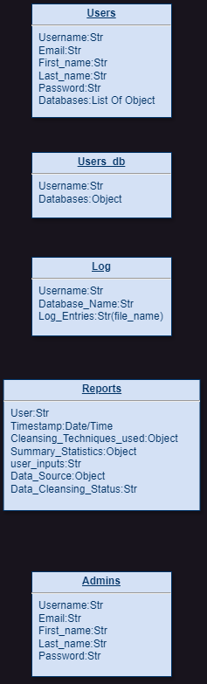
3.1 Database Collection Mapping

Slide 43
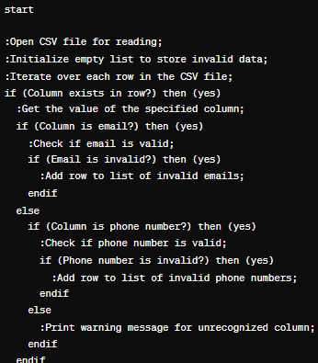
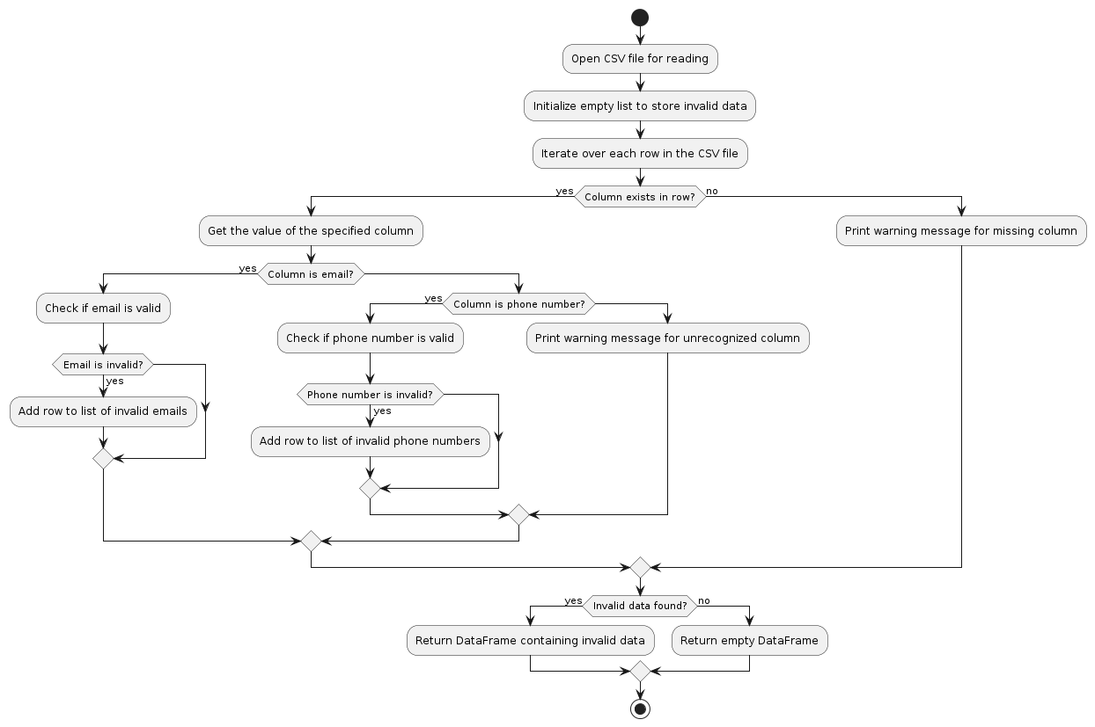
3.2 Pseudocode & Flowcharts
Check Emails
pseudocode
Flowcharts

Slide 44
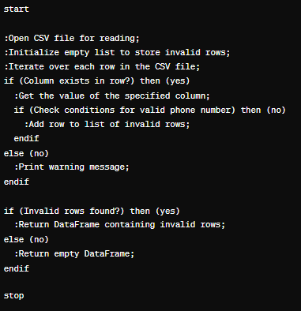
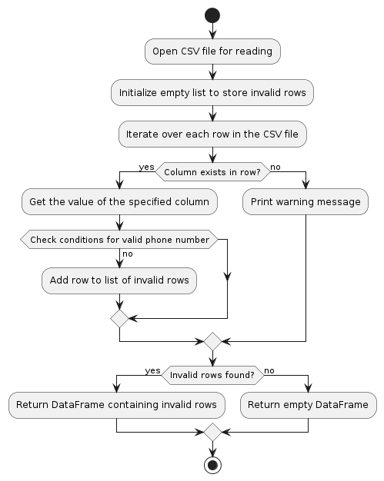
check phone numbers
pseudocode
Flowcharts

Slide 45
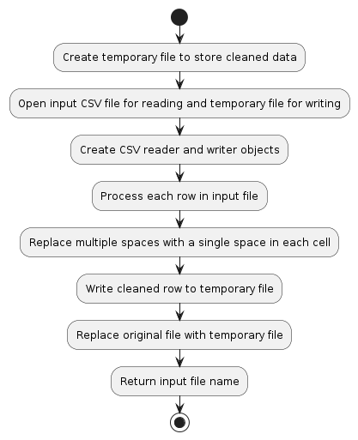
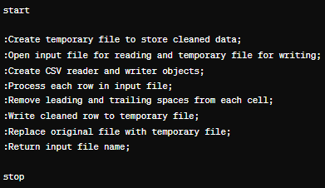
remove strip
pseudocode
Flowcharts

Slide 46
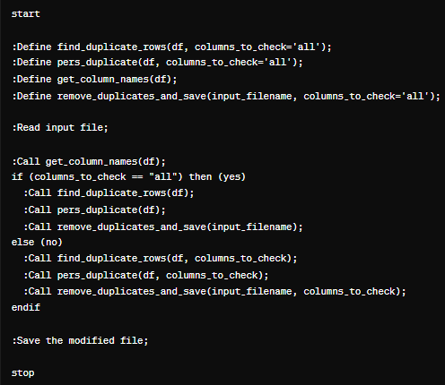
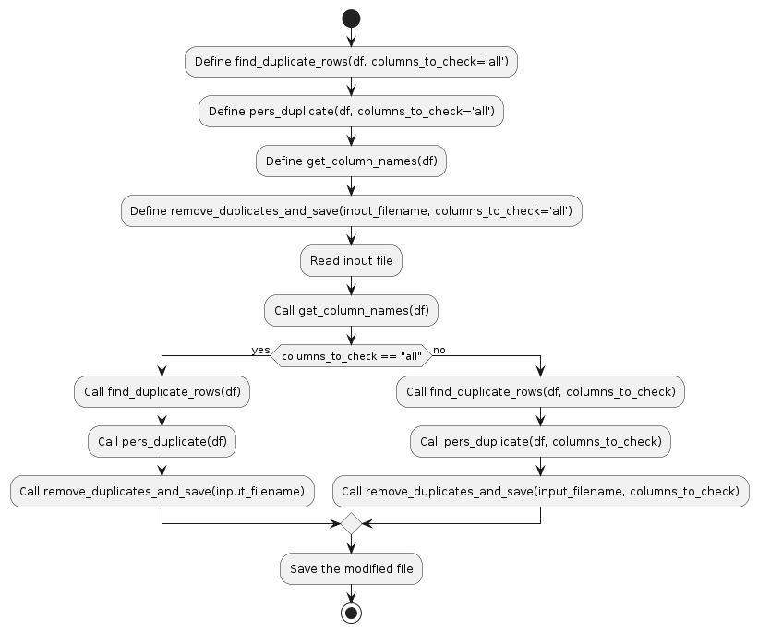
duplicates
pseudocode
Flowcharts

Slide 47
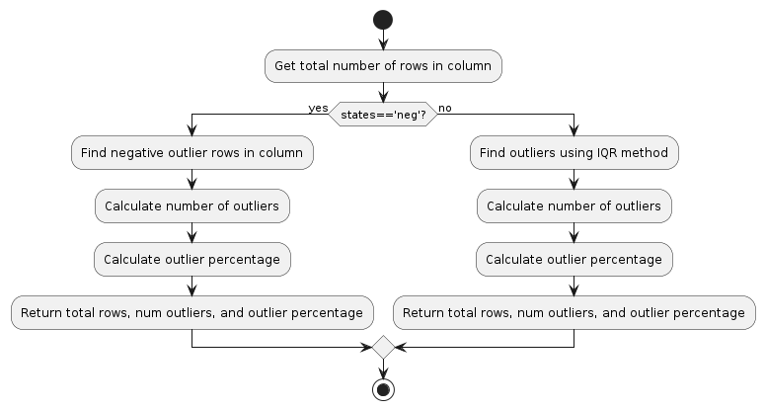
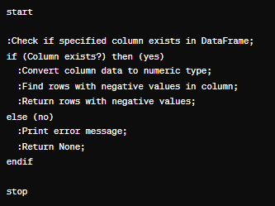
deal with negative outliers
pseudocode
Flowcharts

Slide 48
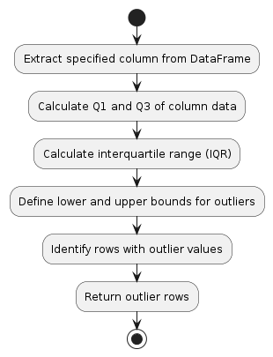
Flowcharts:
find outliers
deal with outliers

Slide 49
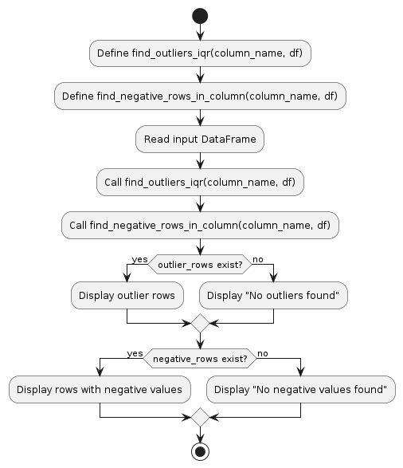
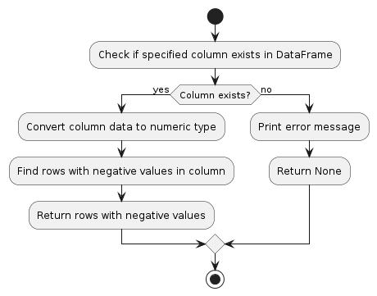
Flowcharts:
negative outlier
outlier structure

Slide 50
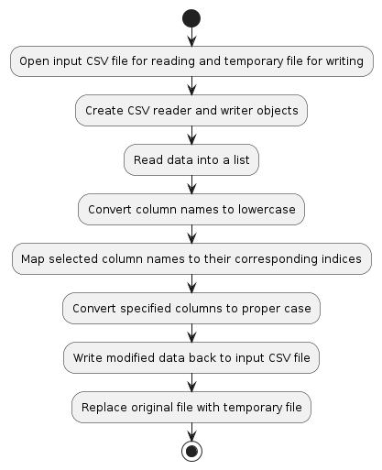
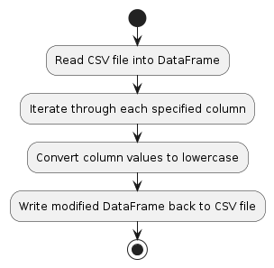
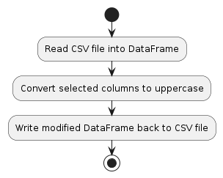
Flowcharts:
upper case
lowercase
proper case

Slide 51
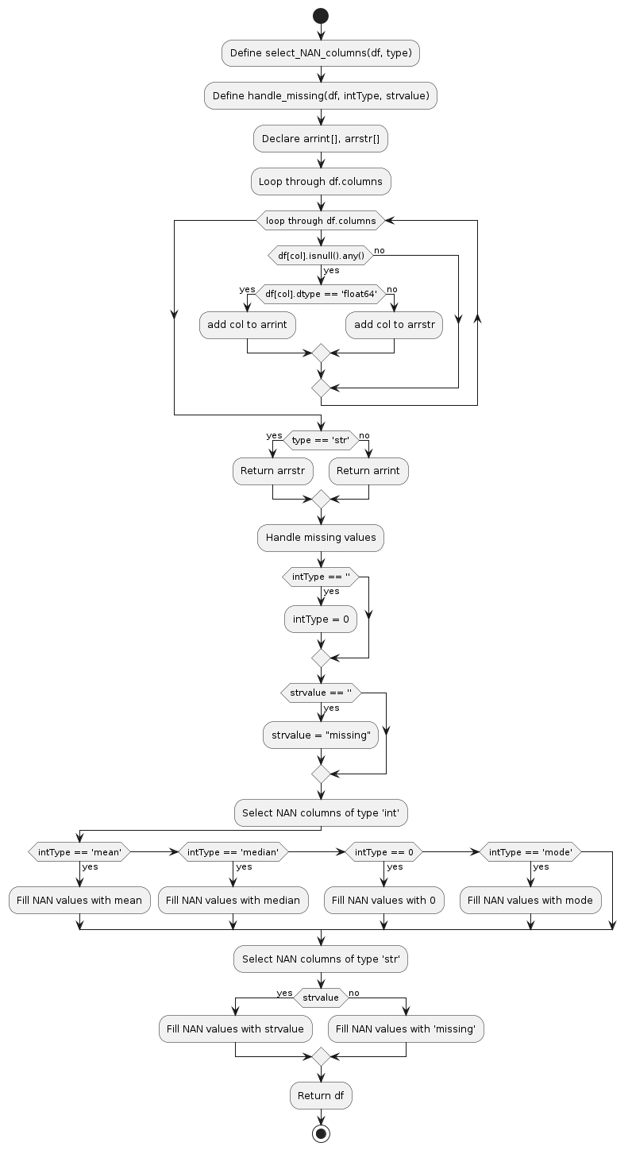
Flowcharts:
missing values

Slide 52
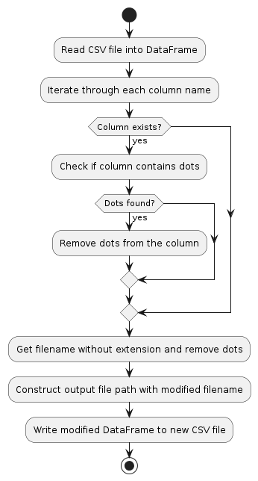
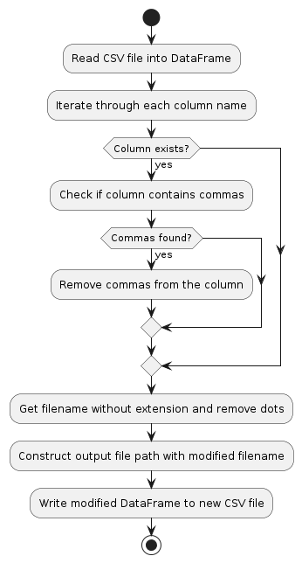
Flowcharts:
remove commas
remove dots

Slide 53
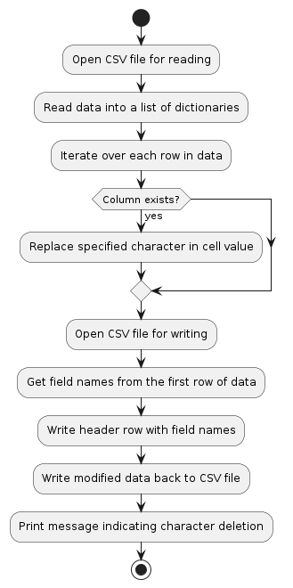
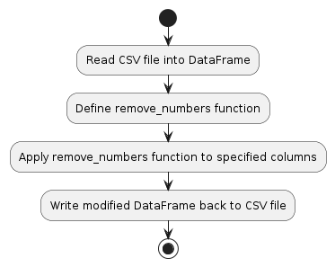
Flowcharts:
remove letters
remove numbers

Slide 54
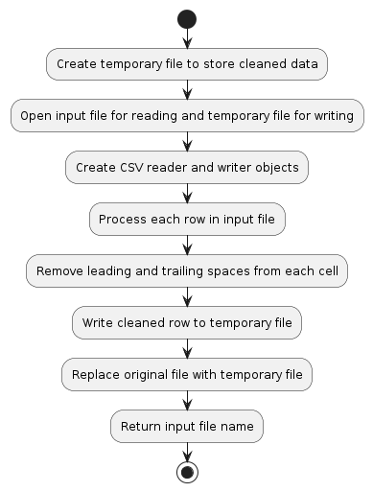
Flowcharts:
remove double spaces
remove strips
(space on the sides)

Slide 55
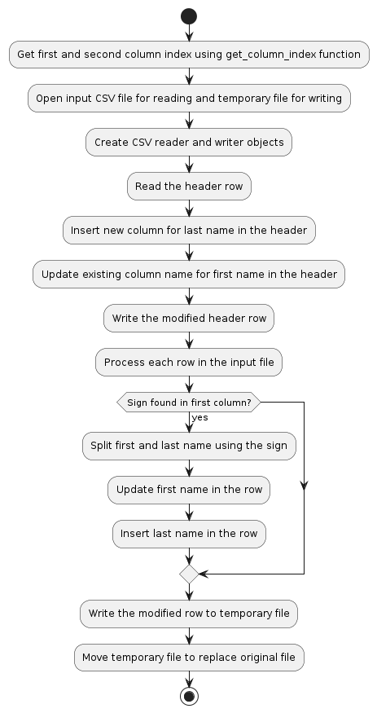
Flowcharts:
split

Slide 56
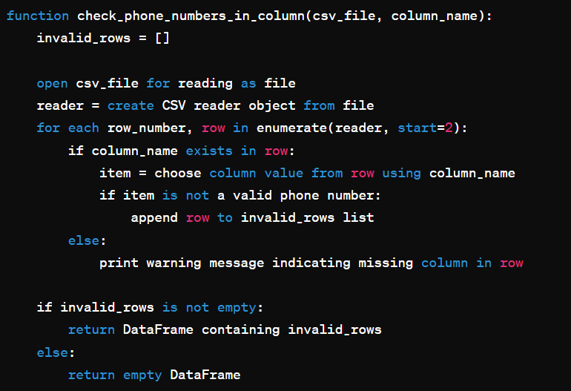
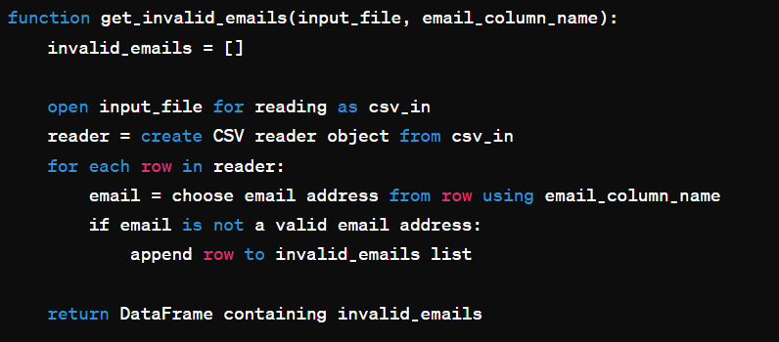
pseudocode:
check emails
check phone

Slide 57
pseudocode:
check email
check phone in column

Slide 58
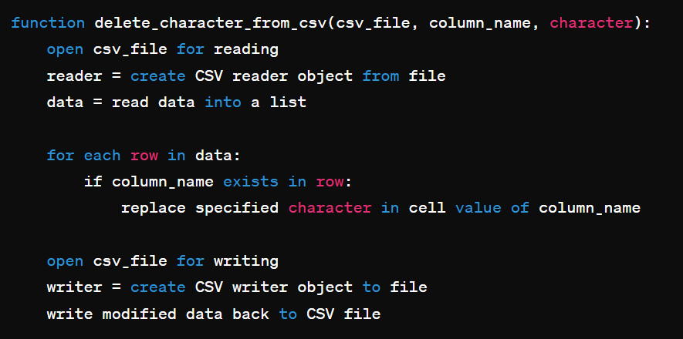
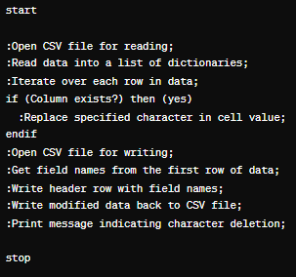
pseudocode:
remove character

Slide 59
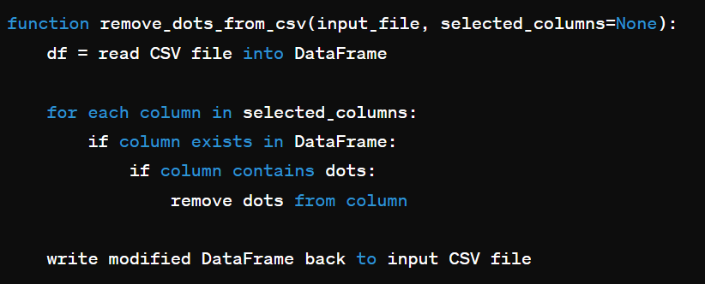
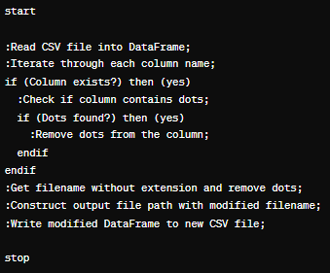
pseudocode:
remove dots

Slide 60
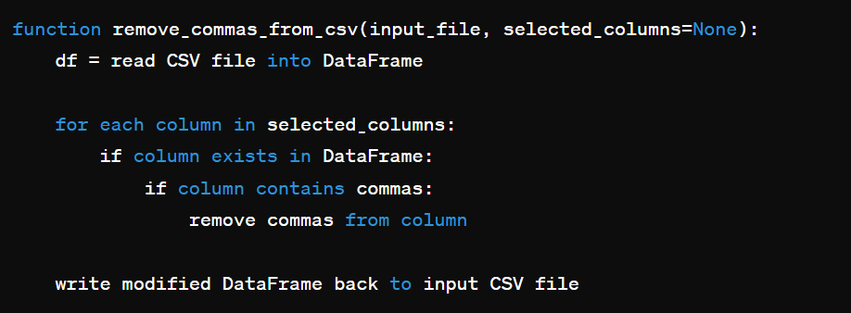
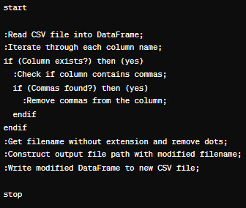
pseudocode:
remove commas

Slide 61
pseudocode:
remove spaces

Slide 62
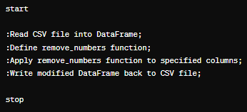
pseudocode:
remove numbers

Slide 63

pseudocode:
calculate outlier percentage

Slide 64


pseudocode:
lower case

Slide 65


pseudocode:
proper case

Slide 66

pseudocode:
upper case

Slide 67

pseudocode:
find outlier

Slide 68
pseudocode:
duplicates

Slide 69

pseudocode:
missing value

Slide 70

pseudocode:
split

Slide 71

3.3 Block diagram

Slide 72




3.4 Figma designs
Login
Sign
Forget Password
Account info

Slide 73



3.4 Figma designs
Home
Home Cont.
Account Management

Slide 74


3.4 Figma designs
Home Cont.
Header
Footer

Slide 75


3.4 Figma designs
Import Page
Export Page

Slide 76


3.4 Figma designs
Dashboard Page
Missing Value

Slide 77


3.4 Figma designs
Duplicate
Invalid

Slide 78

3.4 Figma designs
Outlier

Slide 79
3.5 Analysis Diagrams

Slide 80
List of Diagrams :
Use Case
Class diagram
ER Diagram
Sequence diagram
Activity Diagram
Context Diagram & DFD
Site map

Slide 81

ER Diagram of user Database

Slide 82

Class Diagram

Slide 83

USE Case

Slide 84

Sequence Diagram

Slide 85

ER Diagram of System Database

Slide 86

Site Map

Slide 87
List of researches:
Automation﻿
﻿Data Governance﻿
﻿Anomaly Detection﻿
﻿Data Validation﻿
﻿Data Quality Metrics﻿
﻿Data Profiling
Different database systems working today
﻿Data Cleaning Techniques﻿
﻿Data Transformation﻿
﻿Testing and Validation﻿
﻿Training and Documentation﻿
﻿Data Integration﻿

Slide 88




Conclusion
Automation and Rules: We use smart tools and follow guidelines to organize data and make things run smoother.
Spotting Weird Stuff and Checking Data: We use clever methods to find
odd things and double-check data to make sure it's right.
Checking Data Quality: We use measures and strategies to keep data in good shape, so it's reliable for decision-making.
Taking Care of Data from Start to Finish: We handle data from cleaning it up to putting it together, creating a system that fits our goals.

Slide 89
ch.4
system implementation

Slide 90


4.1 Database Collections
Overview (5 Collections)

Slide 91


4.1 Database Collections
Overview (5 Collections)

Slide 92


4.1 Database Collections
Overview (5 Collections)

Slide 93

4.1 Database Collections
Overview (5 Collections)

Slide 94

4.1 Database Collections
Overview (5 Collections)

Slide 95

4.1 Database Collections
Overview (5 Collections)

Slide 96

4.1 Database Collections
Overview (5 Collections)

Slide 97

4.1 Database Collections
Overview (5 Collections)

Slide 98
4.2 Back-End Implementation Strategy
1.missing values
Fill
Show
Delete
Integer
String
Save
Apply
Mean
Mode
Median

Slide 99
4.2 Back-End Implementation
3.Outlier
1-Calculate the first quartile (Q1) and third quartile (Q3) of the column data
2-Calculate the interquartile range (IQR)
iqr = q3 - q1
3-Define the lower and upper bounds for outlier detection
lower bound = q1 - 1.5 * iqr
upper bound = q3 + 1.5 * iqr

Slide 100




4.2 Back-End Implementation
3.Outlier
Diagrams
Scatter Plot
Box Plot
Histogram
Line Chart

Slide 101
4.2 Back-End Implementation
2.Duplicate Row
Show
Delete
Apply
Save

Slide 102
4.2 Back-End Implementation
4.Invalid format
Remove
Split
num
Strip
Standardized
Check
Slash
,
.
Space
Separator
&
Comma
Lower
Proper
Email
Phone
Upper

Slide 103


4.3 System modules implementation
1.missing values

Slide 104
1.missing values
4.3 System modules implementation
1-Routing and Request Handling:
The Flask application defines a route /Missing to handle requests related to missing value operations using both GET and POST methods.
2- View Function miss():
This function serves as the controller for the /Missing route.
For POST requests:
It retrieves the list of uploaded filenames using get_uploaded_files().
Depending on the operation specified by the user (show, fill, delete), it performs corresponding actions on the uploaded CSV files:
If the operation is show, it displays missing values in the CSV file along with basic statistics.
If the operation is fill, it handles missing values based on user-defined criteria and updates the CSV file accordingly.
If the operation is delete, it removes rows with missing values from the CSV file.
For GET requests, it renders the initial page for uploading files.

Slide 105
1.missing values
4.3 System modules implementation
3. Data Processing Functions:
The function renders the HTML template Missing_value.html, passing relevant data such as filenames, original and modified table HTML, and missing value statistics.
The template dynamically adjusts its content based on user interactions and the operation performed.
4. Data Processing Functions:
The code utilizes several helper functions such as get_uploaded_files(), find_missing_values_rows(), pers_missing(), and handle_missing() to process data and perform operations related to missing values in CSV files.

Slide 106
1.missing values
4.3 System modules implementation
5. Input Validation and Error Handling:
Basic input validation is implemented to ensure that users select a file and provide necessary inputs for filling missing values.
Error messages are displayed when required inputs are missing or invalid.
6. File Operations:
CSV files uploaded by users are read into pandas Data Frames for processing.
Modified Data Frames are saved back to CSV files in the uploads directory.
7. User Interface:
The system provides a user-friendly interface for uploading files, selecting operations, and viewing results.
Feedback messages and error alerts are displayed to guide users through the process.

Slide 107


4.3 System modules implementation
2.Dublicates

Slide 108
2.Dublicates
4.3 System modules implementation
1. Route Definition:
The Flask application defines a route /duplicate to handle requests related to duplicate value operations using both GET and POST methods
2. View Function duplicate():
This function acts as the controller for the /duplicate route.
For POST requests:
It retrieves the list of uploaded filenames using get_uploaded_files().
Depending on the operation specified by the user (show, remove), it carries out corresponding actions on the selected CSV file.
For GET requests, it renders the initial page for selecting files and operations.

Slide 109
2.Dublicates
4.3 System modules implementation
3. Data Processing Function show_dupl():
This function, nested within duplicate(), processes data related to duplicate values.
It reads the selected CSV file into a DataFrame (df) and calculates statistics such as the percentage of duplicate rows and the number of affected rows.
Depending on the selected columns, it identifies duplicate rows using find_duplicate_rows() function.
It generates HTML tables for displaying the original and duplicate rows.

Slide 110
2.Dublicates
4.3 System modules implementation
4.Template Rendering:
The function renders the HTML template duplicate.html, passing relevant data such as filenames, original and duplicate table HTML, statistics, columns, and selected columns.
The template dynamically adjusts its content based on user interactions and the operation performed.
5.Input Validation and Error Handling:
Basic input validation ensures that users select a file and provide necessary inputs for identifying and removing duplicate values.
Error handling manages exceptions that may occur during file processing.

Slide 111
2.Dublicates
4.3 System modules implementation
6. File Operations:
CSV files uploaded by users are read into pandas DataFrames for processing.
Modified DataFrames are saved back to CSV files in the uploads directory after removing duplicate rows.
7. User Interface:
The system offers a user-friendly interface for selecting files, columns, and operations related to duplicate values.
It provides feedback messages and error alerts to assist users throughout the process.

Slide 112



3.outliers
4.3 System modules implementation

Slide 113
3.outliers
4.3 System modules implementation
1. Route Definition:
The route /outlier is defined using the @app.route() decorator in Flask.
The route handles both GET and POST requests, allowing users to interact with the system through form submissions.
2. View Function outlier():
This function is responsible for processing user requests related to outlier detection.
Upon receiving a POST request, it retrieves the list of uploaded filenames using the get_uploaded_files() function.
It extracts the selected filename and operation from the form data.
Depending on the operation specified (show, find_outlier, negative, delete_outlier, delete_negative), it performs corresponding actions.
For GET requests, it renders the initial page for selecting files and operations.

Slide 114
3.outliers
4.3 System modules implementation
3. Data Processing Function show_outlier():
This nested function handles the core data processing tasks related to outlier detection.
It reads the selected CSV file into a pandas DataFrame (df).
It generates HTML tables for displaying the original data and outlier details.
Depending on the operation, it calculates outlier details such as the number of outliers, total rows, and outlier percentage using appropriate functions (getOutliersDetails(), getNegative()).

Slide 115
3.outliers
4.3 System modules implementation
4. Template Rendering:
· The function renders the HTML template outlier.html to display the user interface.
It passes relevant data such as filenames, original and outlier table HTML, statistics, and column names to the template for rendering.
The template is designed to dynamically update its content based on user interactions and the operation performed.
5. Input Validation and Error Handling:
Basic input validation is implemented to ensure that users select a file and provide necessary inputs for outlier detection.
Error handling is incorporated to manage exceptions that may occur during file processing or data manipulation.

Slide 116
3.outliers
4.3 System modules implementation
6. File Operations:
· Uploaded CSV files are read into pandas DataFrames for processing.
· Modified DataFrames, after outlier removal, are saved back to CSV files in the uploads directory.
· Functions like remove_outliers_and_save() and remove_negative_rows() handle the removal of outliers or negative values from the DataFrame and save the modified data back to files.
7. User Interface:
· The system provides a user-friendly interface for users to select files, columns, and operations related to outlier detection.
· It includes interactive elements such as dropdown menus, checkboxes, and buttons to facilitate user interactions.
· Feedback messages and error alerts are displayed to guide users

Slide 117


4. Invalid formats
4.3 System modules implementation

Slide 118


4.3 System modules implementation
4. Invalid formats

Slide 119
4. Invalid formats
4.3 System modules implementation
1. Route Definition:
· The Flask application defines a route /invalid to handle requests related to data validation and formatting.
2. View Function invalid():
· This function serves as the controller for the /invalid route.
· It retrieves the list of uploaded filenames using the get_uploaded_files() function.
· For POST requests:
· It extracts the operation and filename from the form data submitted by the user.
· Depending on the selected operation (show, apply), it performs corresponding actions.
· For GET requests, it renders the initial page for selecting files and operations.

Slide 120
4. Invalid formats
4.3 System modules implementation
3. Data Processing Function show_dupl():
· This nested function handles the core data processing tasks related to data validation and formatting.
· It reads the selected CSV file into a DataFrame (df).
· It generates HTML tables for displaying the original data.
· It is used to render the invalid_format.html template.
4. Template Rendering:
· The function renders the HTML template invalid_format.html, passing relevant data such as filenames, original table HTML, columns, and cleaned data (if applicable).
· The template dynamically adjusts its content based on user interactions and the operation performed.

Slide 121
4. Invalid formats
5. Data Formatting Operations:
Various data formatting operations are supported, including removing characters (e.g., commas, dots, whitespace), converting text case (lowercase, uppercase, proper case), and splitting columns based on separators (e.g., slash, dot, comma).
The user can choose specific columns and apply formatting operations accordingly.
1. Data Validation Operations:
Data validation operations such as checking for invalid email addresses or phone numbers in specific columns are supported.
If invalid data is found, the corresponding rows are displayed in a separate table to inform the user.
6. Input Validation and Error Handling:
Basic input validation is implemented to ensure that users select a file and provide necessary inputs for data validation and formatting.
Error handling manages exceptions that may occur during file processing or data manipulation.

Slide 122
4. Invalid formats
4.3 System modules implementation
7. User Interface:
· The system provides a user-friendly interface for users to select files, columns, and operations related to data validation and formatting.
· Interactive elements such as dropdown menus, checkboxes, and buttons facilitate user interactions.
· Feedback messages and error alerts guide users through the process and provide status updates.

Slide 123

4.4 System Integration

Slide 124

Introduction to System Integration with Flask and Jinja in an MVC Architecture:
In the dynamic landscape of web development, effective system integration is fundamental to building robust and scalable applications. Harnessing the power of frameworks like Flask and templating engines such as Jinja, developers can seamlessly integrate various components within the Model-View-Controller (MVC) architecture. This introduction sets the stage for exploring how Flask, Jinja, and MVC intertwine to create cohesive web applications.
Flask Framework: Flask provides a simple yet powerful framework for developing web applications in Python. Its minimalistic design allows developers to quickly set up and extend functionality as needed. Flask offers features such as URL routing, request handling, and template rendering, making it an ideal choice for building web applications of varying complexities.

Slide 125



Jinja: Jinja is a modern and designer-friendly templating engine for Python, inspired by Django's template system. It allows developers to create dynamic web pages by embedding Python code within HTML templates. Jinja provides features like template inheritance, macros, filters, and control structures, enabling developers to create reusable and maintainable templates.
Routing and Request Handling: Flask's routing mechanism allows developers to map URLs to Python functions, known as view functions. These view functions handle incoming requests, process data, and return responses. By defining appropriate routes, developers can establish communication pathways between different parts of the application.
Missing Value Route With Request Handling
Duplicate Route With Request Handling

Slide 126


Template Rendering with Jinja: Jinja templates enable developers to generate dynamic HTML content by embedding Python code within HTML markup. This allows for the seamless integration of data processed by Flask into the presentation layer of the application. Developers can use Jinja's features like template inheritance and macros to create modular and maintainable templates.
Flask Structure Files:
1-_pycache_: This is a hidden folder that Python creates to store compiled bytecode files to speed up program startup.
2- img: This folder likely h images used in the project.
3- static: This folder typically stores static files such as CSS, JavaScript, or images that are used by the web application.
4- templates: This folder likely stores HTML templates used to generate the web application's user interface.

Slide 127



4.5 Used Softwares
# | Name | Description
1 | Trello | Trello is the visual work management tool that empowers teams to ideate, plan, manage, and celebrate their work together in a collaborative, productive, and organized way.
2 | Drawi.io | Draw.io is an online diagramming tool with integerations with jira,google and confluence available free online or at accost depending on integeration chosen
3 | Visual studio code | Visual Studio is an integrated development environment (IDE) and Visual Studio Code is a rich text editor like Sublime Text and Atom. But the difference between the tools is more than just IDE and text editor. An IDE is a robust tool for writing, editing, debugging, and running your code.

Slide 128



4.5 Used Softwares
# | Name | Description
4 | Notion | Notion is a single space where you can think, write, and plan. Capture thoughts, manage projects, or even run an entire company — and do it exactly the way you want.
5 | Discord | Discord is a free communications app that lets you share voice, video, and text chat with friends, game communities, and developers. It has hundreds of millions of users, making it one of the most popular ways to connect with people online.
6 | Powerpoint ai | PowerPoint (PPT) is a powerful, easy-to-use presentation graphics software program that allows you to create professional-looking electronic slide shows.

Slide 129


4.5 Used Softwares
# | Name | Description
7 | Figma | Figma design is for people to create, share, and test designs for websites, mobile apps, and other digital products and experiences. It is a popular tool for designers, product managers, writers and developers and helps anyone involved in the design process contribute, give feedback, and make better decisions, faster.
8 | Mongodb | MongoDB Compass is a user-friendly graphical interface for interacting with MongoDB databases. It simplifies tasks like data exploration, querying, and administration, offering features for performance monitoring, schema visualization, and index management. It's designed to streamline database interaction for developers, administrators, and analysts.

Slide 130


4.5 Used technology
# | Name | Description
1 | Flask API | Flask is a lightweight web framework for Python. Flask API allows developers to build web APIs using Flask, providing tools and extensions to streamline the process.
2 | Jinja 2 | Jinja2 is a modern and designer-friendly templating language for Python, modelled after Django's templates. It is a text-based template language that renders templates to produce documents.

Slide 131


4.5 Used technology
# | Name | Description
3 | Python 3 | Python is a high-level programming language known for its simplicity and readability. Python 3 is the latest major release of the Python programming language, featuring improvements over Python 2.x.
4 | Bootstrap | Bootstrap is a popular open-source CSS framework for building responsive and mobile-first websites and web applications. It provides pre-designed templates and components for easier development.

Slide 132


4.5 Used technology
# | Name | Description
5 | css | CSS is the acronym of “Cascading Style Sheets”. CSS is a computer language for laying out and structuring web pages (HTML or XML). This language contains coding elements and is composed of these “cascading style sheets” which are equally called CSS files.
6 | Csv editor | A CSV (Comma-Separated Values) editor is a tool used to view, edit, and manipulate CSV files. It typically provides features for importing, exporting, sorting, filtering, and formatting CSV data, making it easier to work with tabular data in spreadsheet-like formats.

Slide 133

4.6 system Shot Screens:- Missing values page:

Slide 134

4.6 system Shot Screens:- Missing values results:

Slide 135

4.6 system Shot Screens:- Duplicates:

Slide 136

4.6 system Shot Screens:- Duplicates results:

Slide 137

4.6 system Shot Screens:- Outliers:

Slide 138

4.6 system Shot Screens:- Outliers results:

Slide 139

4.6 system Shot Screens:- invalid formats:

Slide 140

4.6 system Shot Screens:- invalid formats results:

Slide 141

Ch.5
system testing

Slide 142

Testcase
1:upload database

Slide 143

Testcase 2: Login

Slide 144

Testcase 3: register

Slide 145

Testcase 4: remove duplicates

Slide 146

Testcase 5: missing values

Slide 147

Testcase 6: delete outliers

Slide 148

Testcase 7: invalid formats

Slide 149

Testcase 7: invalid formats cont.

Slide 150
ch.6
system demo

Slide 151

Ch.7
conclusion and future work

Slide 152

Conclusion
Our data cleansing website, integrated with Flask and developed using HTML, CSS, and Python, marks a significant leap forward in addressing data quality challenges comprehensively.
By prioritizing critical issues like missing values, invalid formats, outliers, and duplicates, our approach ensures a targeted cleansing process that effectively resolves key data quality challenges.
The platform boasts an intuitive user interface and detailed graphical representations, empowering users to effortlessly clean and visualize their databases while making informed decisions.
Offering flexibility in exporting data across various formats, the platform also provides comprehensive training modules to equip users with effective database management skills.

Slide 153

Conclusion
Our cleansing process preserves the original structure of the database, maintaining the format of the data throughout.
Guided by Agile methodologies, our development process is iterative and responsive, allowing us to continually refine and enhance the A to meet evolving user needs effectively.
Looking ahead, the platform remains poised for future enhancements, promising even greater efficiency and responsiveness to evolving user needs.
User feedback plays a crucial role in shaping the evolution of the platform, ensuring that it continues to meet the diverse needs of its user base.

Slide 154

Ch.7
future work

Slide 155


10. Training and Support
In-App Tutorials: Develop comprehensive in-app tutorials and guides to help users understand how to use the application effectively.
Community and Support Forum: Establish a community forum and support channels to provide users with a platform for discussion, troubleshooting, and sharing best practices.
future work
1. Advanced Cleaning Techniques
3. Integration and Interoperability
Cloud Storage Support: Enable integration with popular cloud storage solutions like AWS S3, Google Drive, and Dropbox for easy data import and export.
Automated Error Detection
Implement machine learning algorithms to automatically detect and suggest corrections for common data errors, such as typos, duplicates, and inconsistencies.
Natural Language Processing (NLP)
Use NLP to clean and standardize text data, especially useful for processing unstructured datalike reviews or comments
6. Collaboration and Sharing
User Roles and Permissions: Implement a robust user management system to allow for role-based access control, ensuring that only authorized users can perform certain actions.
Real-Time Collaboration: Enable real-time collaboration features so multiple users can work on the same dataset simultaneously.
7. Enhanced Reporting and Monitoring
Audit Logs: Maintain detailed logs of all data cleaning activities for accountability and tracking purposes.
Custom Reports: Provide tools for generating custom reports that summarize the results of data cleaning operations.
6. Collaboration and Sharing
User Roles and Permissions: Implement a robust user management system to allow for role-based access control, ensuring that only authorized users can perform certain actions.
Real-Time Collaboration: Enable real-time collaboration features so multiple users can work on the same dataset simultaneously.
5. Security
Data Encryption: Ensure that all data, both in transit and at rest, is encrypted to protect sensitive information.

Slide 156
10. Training and Support
In-App Tutorials: Develop comprehensive in-app tutorials and guides to help users understand how to use the application effectively.
Community and Support Forum: Establish a community forum and support channels to provide users with a platform for discussion, troubleshooting, and sharing best practices.
future work
2. Enhanced User Interface and Experience
3. Integration and Interoperability
Cloud Storage Support: Enable integration with popular cloud storage solutions like AWS S3, Google Drive, and Dropbox for easy data import and export.
Drag-and-Drop Functionality
Simplify the user experience by enabling drag-and-drop capabilities for data import and export
Customization Options
Allow users to customize cleaning rules and workflows to better fit their specific needs.
6. Collaboration and Sharing
User Roles and Permissions: Implement a robust user management system to allow for role-based access control, ensuring that only authorized users can perform certain actions.
Real-Time Collaboration: Enable real-time collaboration features so multiple users can work on the same dataset simultaneously.
7. Enhanced Reporting and Monitoring
Audit Logs: Maintain detailed logs of all data cleaning activities for accountability and tracking purposes.
Custom Reports: Provide tools for generating custom reports that summarize the results of data cleaning operations.
6. Collaboration and Sharing
User Roles and Permissions: Implement a robust user management system to allow for role-based access control, ensuring that only authorized users can perform certain actions.
Real-Time Collaboration: Enable real-time collaboration features so multiple users can work on the same dataset simultaneously.
5. Security
Data Encryption: Ensure that all data, both in transit and at rest, is encrypted to protect sensitive information.

Slide 157
10. Training and Support
In-App Tutorials: Develop comprehensive in-app tutorials and guides to help users understand how to use the application effectively.
Community and Support Forum: Establish a community forum and support channels to provide users with a platform for discussion, troubleshooting, and sharing best practices.
future work
3. Integration and Interoperability
4. Security
3. Integration and Interoperability
Cloud Storage Support: Enable integration with popular cloud storage solutions like AWS S3, Google Drive, and Dropbox for easy data import and export.
Cloud Storage Support
Enable integration with popular cloud storage solutions like AWS S3, Google Drive, and Dropbox for easy data import and export.
Data Encryption
Ensure that all data, both in transit and at rest, is encrypted to protect sensitive information.
6. Collaboration and Sharing
User Roles and Permissions: Implement a robust user management system to allow for role-based access control, ensuring that only authorized users can perform certain actions.
Real-Time Collaboration: Enable real-time collaboration features so multiple users can work on the same dataset simultaneously.
7. Enhanced Reporting and Monitoring
Audit Logs: Maintain detailed logs of all data cleaning activities for accountability and tracking purposes.
Custom Reports: Provide tools for generating custom reports that summarize the results of data cleaning operations.
6. Collaboration and Sharing
User Roles and Permissions: Implement a robust user management system to allow for role-based access control, ensuring that only authorized users can perform certain actions.
Real-Time Collaboration: Enable real-time collaboration features so multiple users can work on the same dataset simultaneously.
5. Security
Data Encryption: Ensure that all data, both in transit and at rest, is encrypted to protect sensitive information.

Slide 158
10. Training and Support
In-App Tutorials: Develop comprehensive in-app tutorials and guides to help users understand how to use the application effectively.
Community and Support Forum: Establish a community forum and support channels to provide users with a platform for discussion, troubleshooting, and sharing best practices.
future work
5. Enhanced Reporting and Monitoring
3. Integration and Interoperability
Cloud Storage Support: Enable integration with popular cloud storage solutions like AWS S3, Google Drive, and Dropbox for easy data import and export.
Audit Logs
Maintain detailed logs of all data cleaning activities for accountability and tracking purposes.
Custom Reports
Provide tools for generating custom reports that summarize the results of data cleaning operations.
6. Collaboration and Sharing
User Roles and Permissions: Implement a robust user management system to allow for role-based access control, ensuring that only authorized users can perform certain actions.
Real-Time Collaboration: Enable real-time collaboration features so multiple users can work on the same dataset simultaneously.
7. Enhanced Reporting and Monitoring
Audit Logs: Maintain detailed logs of all data cleaning activities for accountability and tracking purposes.
Custom Reports: Provide tools for generating custom reports that summarize the results of data cleaning operations.
6. Collaboration and Sharing
User Roles and Permissions: Implement a robust user management system to allow for role-based access control, ensuring that only authorized users can perform certain actions.
Real-Time Collaboration: Enable real-time collaboration features so multiple users can work on the same dataset simultaneously.
5. Security
Data Encryption: Ensure that all data, both in transit and at rest, is encrypted to protect sensitive information.

Slide 159
10. Training and Support
In-App Tutorials: Develop comprehensive in-app tutorials and guides to help users understand how to use the application effectively.
Community and Support Forum: Establish a community forum and support channels to provide users with a platform for discussion, troubleshooting, and sharing best practices.
future work
6. Training and Support
3. Integration and Interoperability
Cloud Storage Support: Enable integration with popular cloud storage solutions like AWS S3, Google Drive, and Dropbox for easy data import and export.
In-App Tutorials
Develop comprehensive in-app tutorials and guides to help users understand how to use the application effectively
Community and Support Forum
Provide tools for generating custom reports that summarize the results of data cleaning operations.
6. Collaboration and Sharing
User Roles and Permissions: Implement a robust user management system to allow for role-based access control, ensuring that only authorized users can perform certain actions.
Real-Time Collaboration: Enable real-time collaboration features so multiple users can work on the same dataset simultaneously.
7. Enhanced Reporting and Monitoring
Audit Logs: Maintain detailed logs of all data cleaning activities for accountability and tracking purposes.
Custom Reports: Provide tools for generating custom reports that summarize the results of data cleaning operations.
6. Collaboration and Sharing
User Roles and Permissions: Implement a robust user management system to allow for role-based access control, ensuring that only authorized users can perform certain actions.
Real-Time Collaboration: Enable real-time collaboration features so multiple users can work on the same dataset simultaneously.
5. Security
Data Encryption: Ensure that all data, both in transit and at rest, is encrypted to protect sensitive information.

